Slide 1
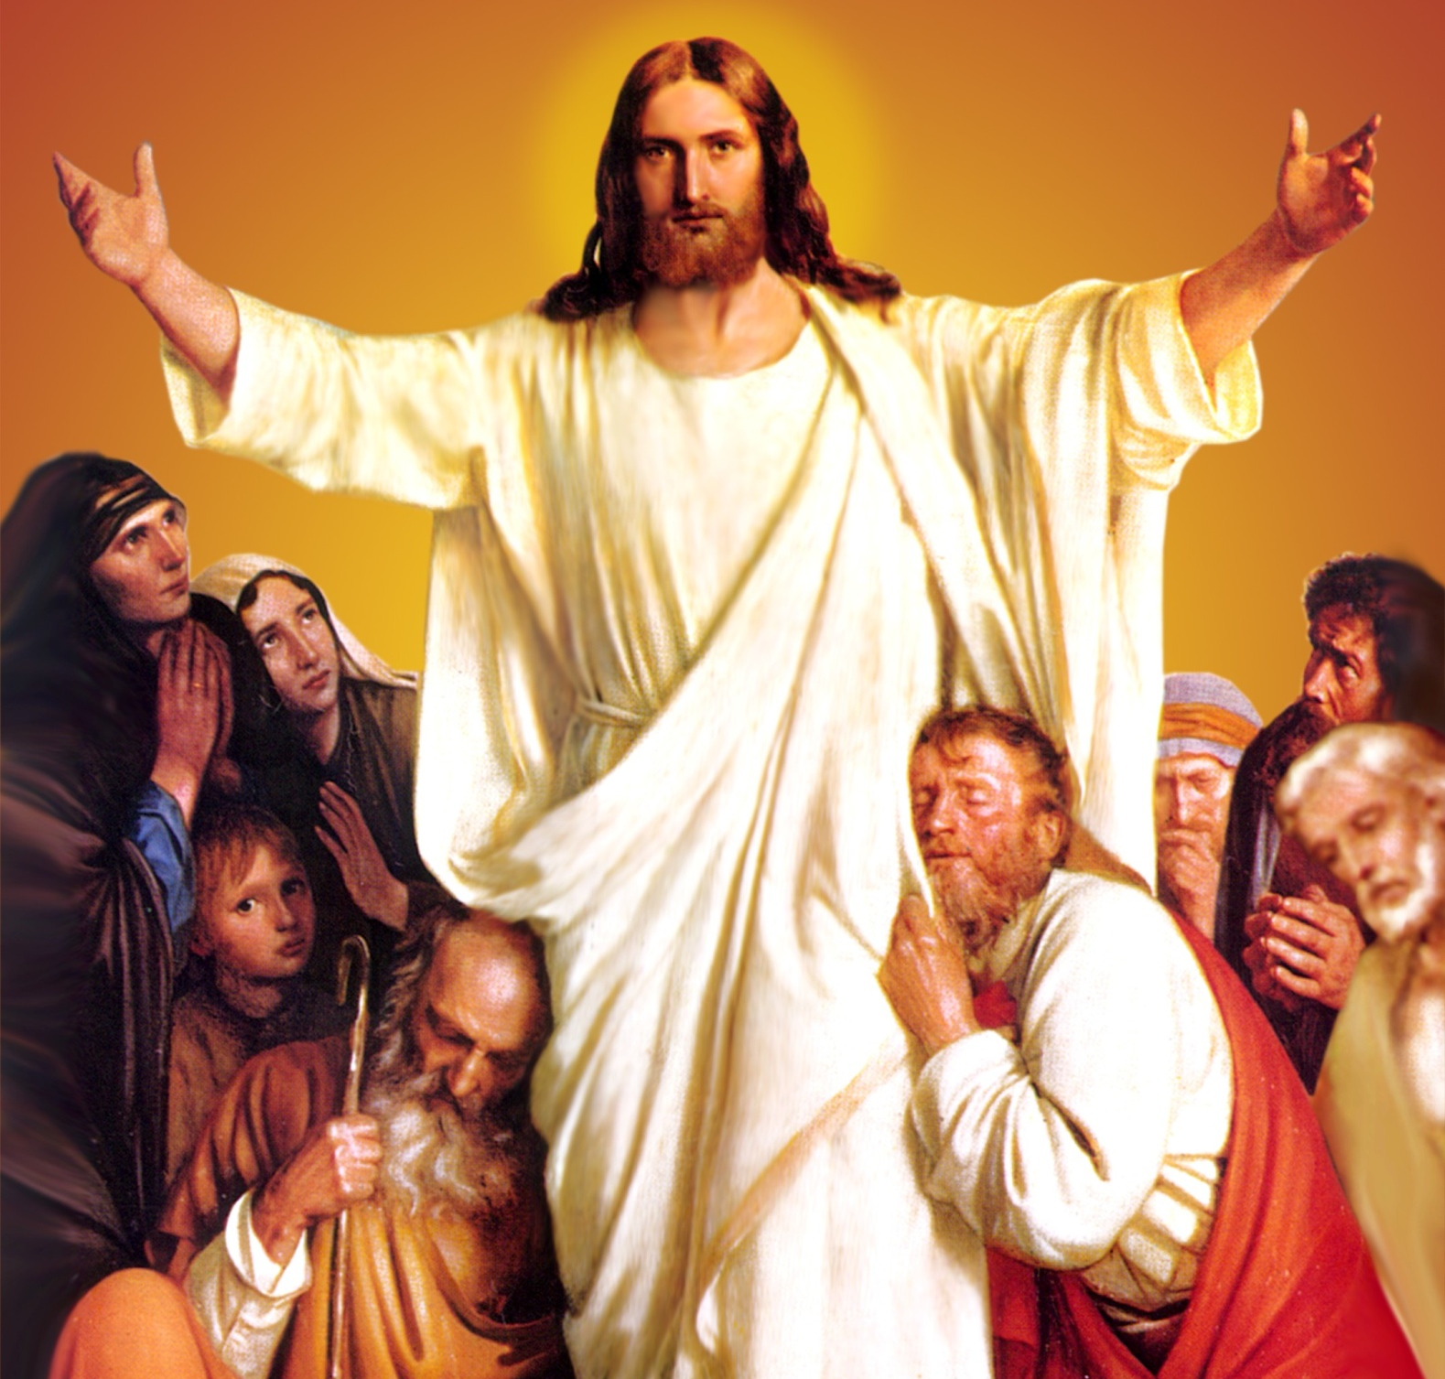
CATECHETICAL TEXTBOOK SERIES OF THE SYRO - MALABAR CHURCH
ON THE PATH OF SALVATION - 6
PEOPLE WHO
EXPERIENCED JESUS
6

Slide 2
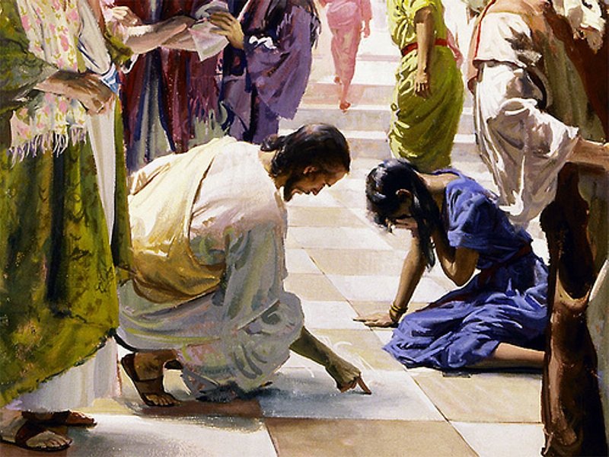
LESSON 6
JESUS WHO CAME IN SEARCH OF SINNERS

Slide 3
A young man was feeding pigs on an empty stomach. He wished he could eat at least the pods given to the pigs. But no one gave him anything. Then he began to count all the luxuries in his father's house that he had lost through foolishness. The younger of the two sons of a rich father, he had claimed his share from his father and left home to live as he pleased. Leading a life of luxury with his friends, he squandered all the money in a short while. Finally he got hired to feed a herd of pigs - animals considered most unclean by the Jews. Thoughts of his father's house led him to repentance. He desired to go back to his father.

Slide 4
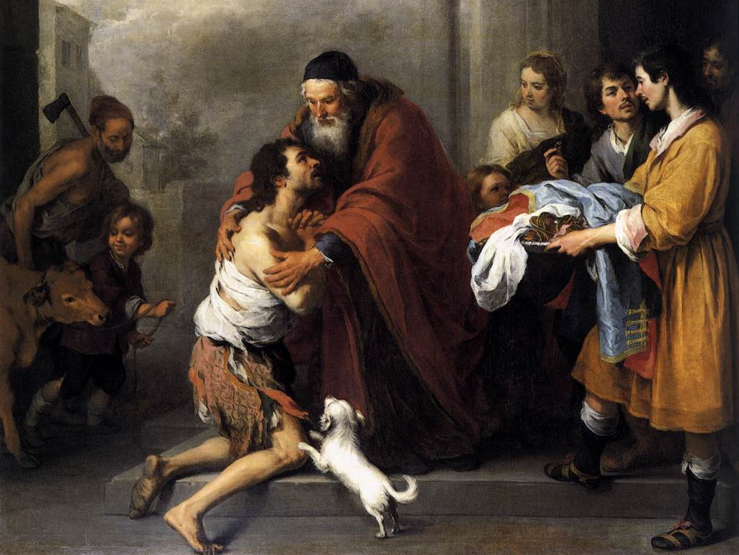
He decided, 'I will get up and go to my father and I will say to him, “Father I have sinned against heaven and against you; I am no longer worthy to be called your son; treat me like one of your hired hands”. He got up and went to his father. As for his father, he was awaiting the return of his son. He recognized the son from a long way off. Running to him the father put his arms around him and kissed him. He ordered his servants to give him fresh clothes, shoes, and a ring and to prepare a feast for him. The father restored to this prodigal son everything he had lost (Lk. 15: 11- 24).
Through this 'parable of the prodigal son' Jesus illustrates the infinite mercy of God towards sinners who repent. Jesus reveals to us the great love of God the Father who awaits patiently the return of sinners and who is merciful towards those who repent.

Slide 5
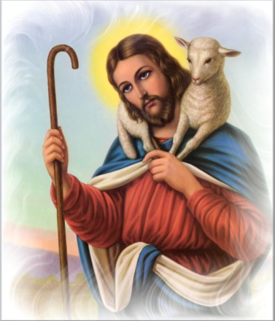
PARABLE OF THE LOST SHEEP
Jesus is the Good Shepherd who goes in search of lost sheep. 'So he told them this parable: “Which one of you, having a hundred sheep and losing one of them, does not leave the ninety-nine in the wilderness and go after the one that is lost until he finds it? When he has found it, he lays it on his shoulders and rejoices. And when he comes home he calls together his friends and neighbours, saying to them, 'Rejoice with me, for I have found my sheep that was lost'.
Just so I tell you, there will be more joy in heaven over one sinner who repents than over ninety-nine righteous persons who need no repentance” (Lk. 15: 3- 7). Jesus uses this parable as an illustration for the scribes and Pharisees who accused him of eating with sinners and tax collectors. Through this he also reveals that there will be great rejoicing in heaven over one sinner who repents.

Slide 6
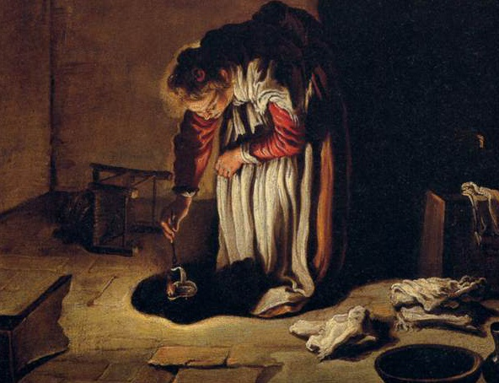
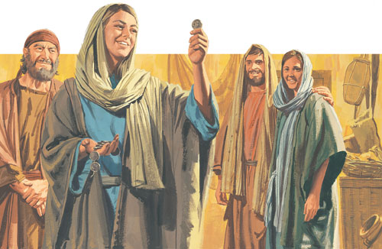
PARABLE OF THE LOST COIN
Jesus reveals the depth of this joy through another parable, that of the lost coin. A woman has ten valuable coins. If she were to lose one of them, she would not overlook it. She would search frantically for it. Once she finds it she would call her friends and neighbours to rejoice with her. The joy in heaven over one sinner who repents is similar to the joy of the woman who finds her lost coin. (Lk. 15: 8- 10).

Slide 7
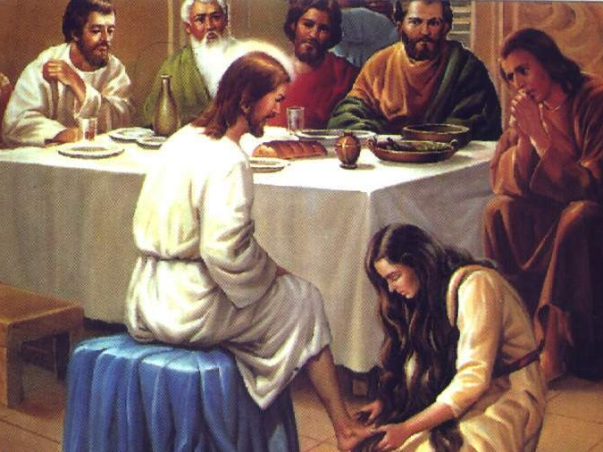
A SINFUL WOMAN FORGIVEN
One of the Pharisees asked Jesus to eat with him, and he went into the Pharisee's house and took his place at the table. And a woman in the city, who was a sinner, having learned that he was there, brought an albaster jar of ointment. She knelt behind him at his feet, weeping, and began to bathe his feet with her tears and to dry them with her hair. Then she continued kissing his feet and anointing them with the ointment. Now, when the Pharisee who had invited him saw this, he said to himself, “If this man was a prophet, he would have known who and what kind of woman this is, who is touching him, that she is a sinner.”

Slide 8
Jesus spoke up and said to him, “Simon, I have something to say to you.” “Teacher”, he replied, “Speak.” “A certain creditor had two debtors; one owed five hundred denari and the other, fifty. When they could not pay, he cancelled the debts of both of them. Now, which of them will love him more?” Simon answered, “I suppose the one for whom he cancelled the greater debt.” And Jesus said to him, “You have judged rightly.”

Slide 9
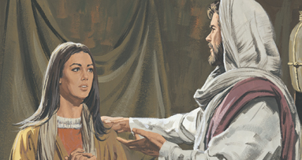
Then turning towards the woman he said to Simon, “Do you see this woman? I entered your house; you gave me no water for my feet, but she has bathed my feet with her tears and dried them with her hair. You gave me no kiss, but from the time I came in she has not stopped kissing my feet. You did not anoint my head with oil, but she has anointed my feet with ointment. Therefore I tell you, her sins, which were many, have been forgiven; hence she has shown great love. But the one to whom little is forgiven, loves little.” Then he said to her, “Your sins are forgiven” (Lk. 7: 36- 49). These words of Jesus show us, how merciful God is towards repentant sinners.

Slide 10
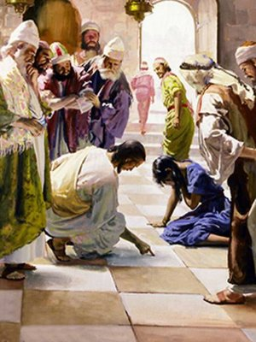
THE WOMAN CAUGHT IN ADULTERY
Once, Jesus was teaching in the temple. The scribes and Pharisees brought a woman who had been caught in adultery; and making her stand before all of them, they said to him, “Teacher, this woman was caught in the very act of committing adultery. Now in the law Moses commanded us to stone such women. Now what do you say?” They said this to test him, so that they might have some charge to bring against him. Jesus bent down and wrote with his finger on the ground.
When they kept on questioning him, he straightened up and said to them, “Let anyone among you who is without sin be the first one to throw a stone at her.” And once again he bent down and wrote on the ground. When they heard it, they went away, one by one, beginning with the elders; and Jesus was left alone with the woman standing before him. Jesus straightened up and said to her, “Woman, where are they? Has no one condemned you?” She said, “No one sir.” And Jesus said, “Neither do I condemn you. Go your way, and from now on do not sin again” (Jn. 8:1- 11).

Slide 11
Jesus saved this woman who should have been stoned to death according to the law of Moses, from death as well as from the ways of sin. Jesus, who comes in search of sinners and blesses them with forgiveness, asks one thing from such people: “Sin no more”. Let us try not to sin ever. If ever we sin, let us immediately turn back to Jesus in repentance. We will then enjoy the peace and bliss of our merciful God.

Slide 12
Let us pray
O! Jesus, who came in search of sinners, we confess our sins like the prodigal son. Help us to meditate on your teachings and reach eternal life by leading a life according to them.

Slide 13
Read the word of god:
Luke. 15:1-31

Slide 14
WORD OF GOD FOR GUIDANCE
"There will be more joy in heaven over one sinner who repents than over ninty - nine righteous persons who need no repentance." (Lk. 15:7)

Slide 15
LET US DO:
Read the parable of the prodigal son and present
it in the form of a short play.

Slide 16
MY DECISION
I will receive the sacrament of reconcilation as soon as
I happen to commit a sin.

Slide 17
LET US Find out the answer
1. What was the decision of the prodigal son who repented of his sins?
2. What does Jesus reveal through the parable of the prodigal son?
3. What is the message of the parable of the lost sheep?
4. Why did Jesus forgive the various sins of the sinful woman?
5. What does Jesus demand from those who are forgiven their sins?

Slide 18
Thank you

